Slide 1

Basic’s of Single Board Computer
Lecturer: Reza Arjmandi
Summer 2016
Preface:
Introduction SBC, Raspberry pi and course outlines.

Slide 2
The aim is…
What is a SBC (Single-Board Computer)?
What is a Embedded System?
What should we learn?

Slide 3
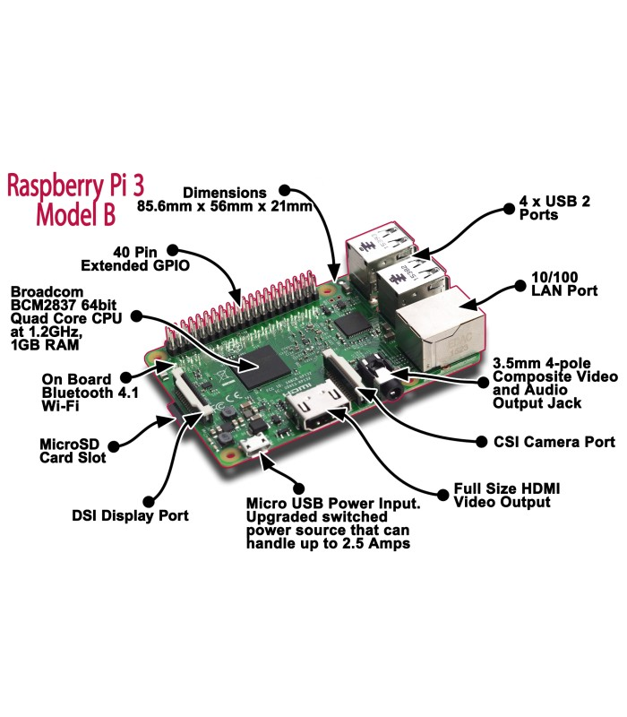

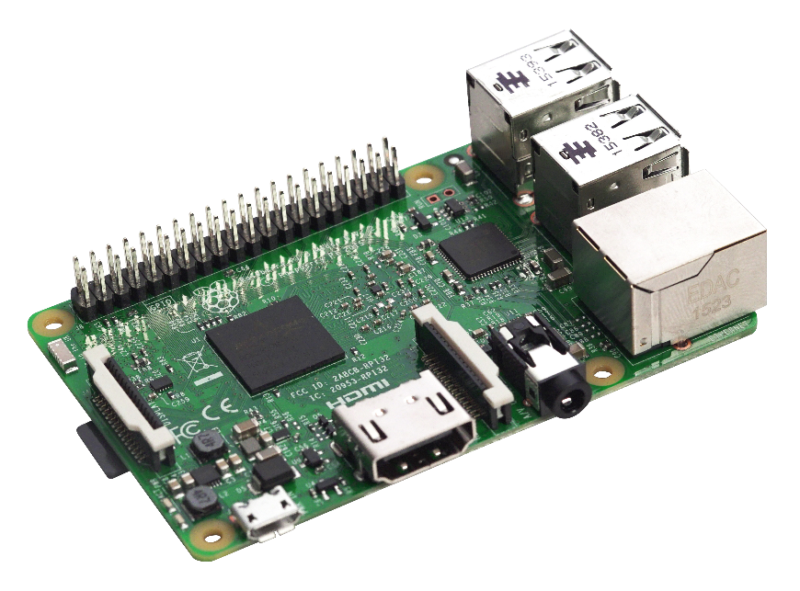
Single Board computer

Slide 4
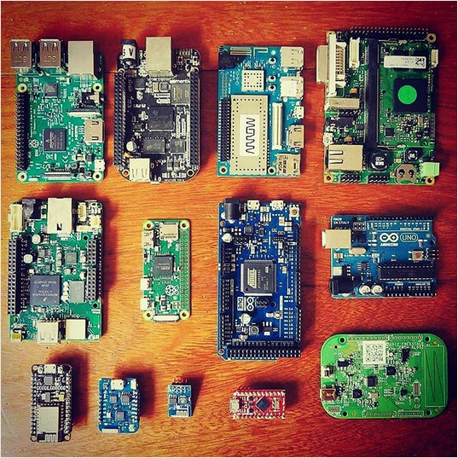
Producer
Raspberry pi
ODROID
Orange Pi
BeagleBone Black
Friendly ARM
Microsoft
…

Slide 5
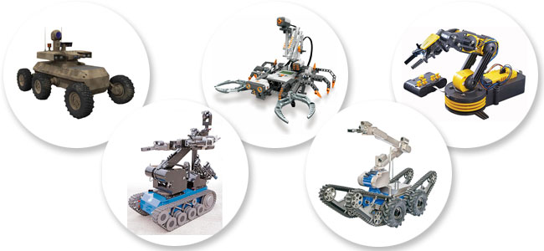
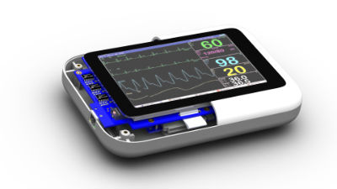
Application
Robotic
Home Automation
Video Game
Computer vision
Home Security
Mechatronics
Networking
Secret Agents
Embdded System

Slide 6
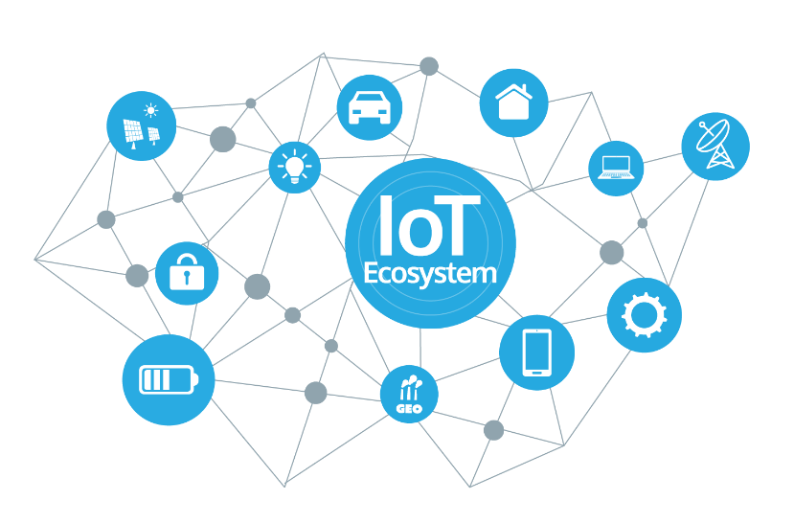
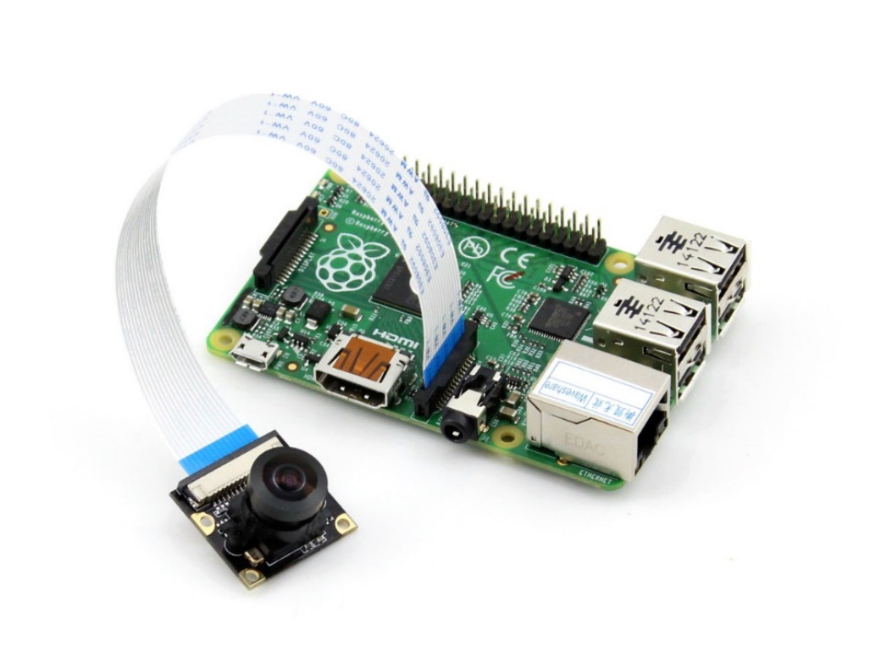






Outlines
Python
git – GitHub
IOT
Controlling Hardware
Image Processing
Embed linux

Slide 7




Programming
Raspberry Pi support several programming language:
Python is a programming language that lets you work quickly and integrate systems more effectively
Use Python for:
Web Programming: Django, Pyramid, Bottle, Tornado, Flask, web2py
GUI Development: wxPython, tkInter, PyGtk, PyGObject, PyQt
Scientific and Numeric: SciPy, Pandas, IPython
Software Development: Buildbot, Trac, Roundup
System Administration: Ansible, Salt, OpenStack

Slide 8
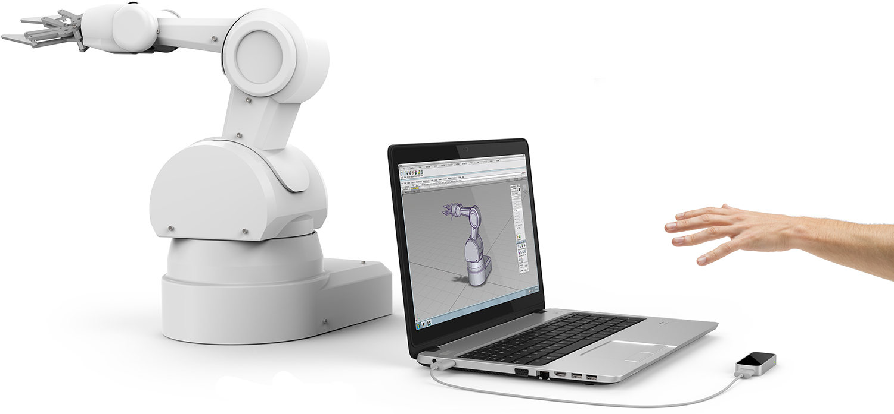
User Interface Technolgies
CLI
GUI
Web
Gesture Recognition
Speech Recognition
…

Slide 9
Python
Native Datatypes
Python Containers
Comprehensions
Strings
Regular Expressions
Closures And Generators
Classes And Iterators
Advanced Iterators
Tkinter and PyQT GUI Development
Bottle framework (web development)

Slide 10
git-GitHub
For getting course project files, presentation and all practices with run command in terminal:
sudo git clone git@github.com:reza-arjmandi/rpi-course.git
Also you can use GitHub Desktop application from following link (suitable for windows os):
https://desktop.github.com/

Slide 11






IOT
Dweet(M2M protocol)
IFTTT
Freeboard
ThingSpeak
Bottle framework(web development)
ZMQ technology(datastream network)

Slide 12
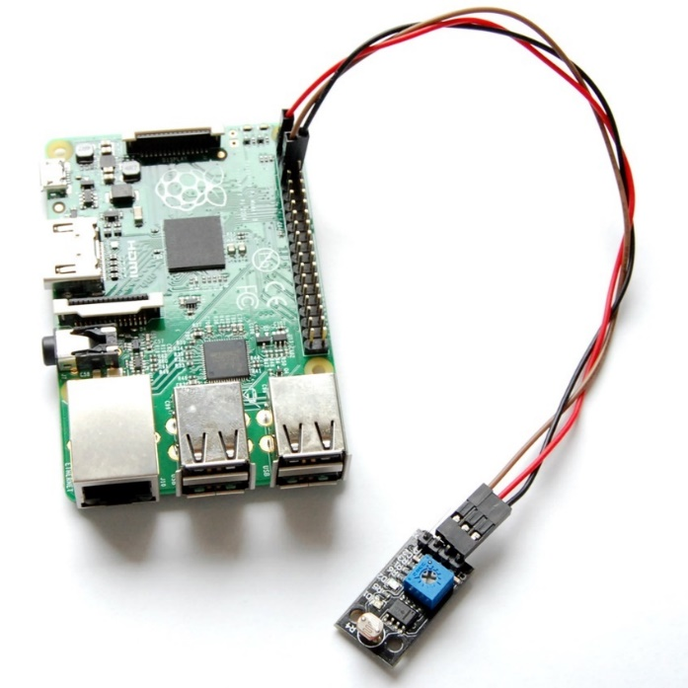
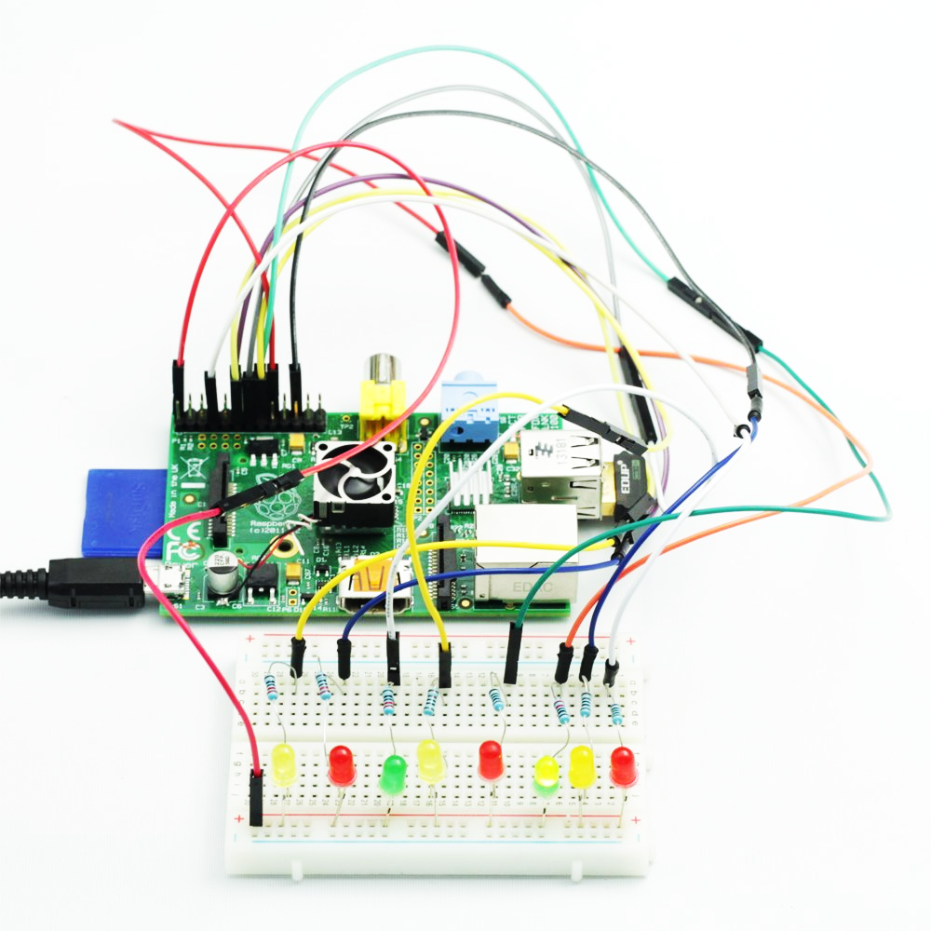
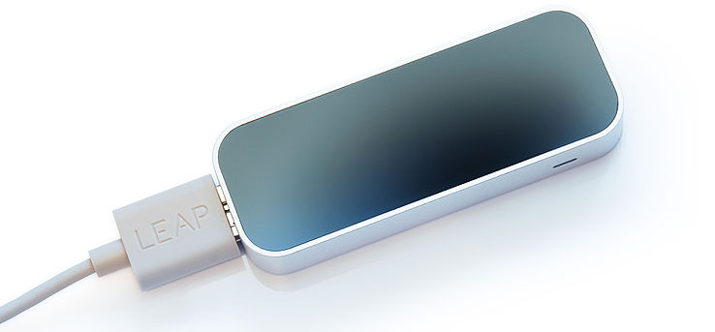
Controlling Hardware
GPIO, I2C
OLED
DC motor
Stepper Motor
Leap Motion
Distance Measurment Sensor
Camera

Slide 13
Image Processing
OpenCV (Python Wrapper)
Circle Detection
Face Detection
Motion Detection
USB webcam
CSI Camera

Slide 14
Embed Linux
Linux Shell (Bash)
GPIO Software Driver Programming
Network Configuration
SSH
Linux Configuration
Remote Desktop (VNC)

Slide 15


Contact us
www.e-system.ir
Info@e-system.ir

